Slide 1
Research on the possibility to play the wiki race game using subreddits
Dmitry Milya, 3530903/80302

Slide 2

introduction
A Wikirace is a race between any number of participants, using links to travel from one Wikipedia page to another. The first person to reach the destination page, or the person that reaches the destination using the fewest links, wins the race. Intermediary pages may also be required.
The goal of this research is to find out whether it is possible, and if yes then if it is easy enough for a human, to play the Wikirace game on Reddit with subreddits instead of pages using crossposts as links between them.

Slide 3
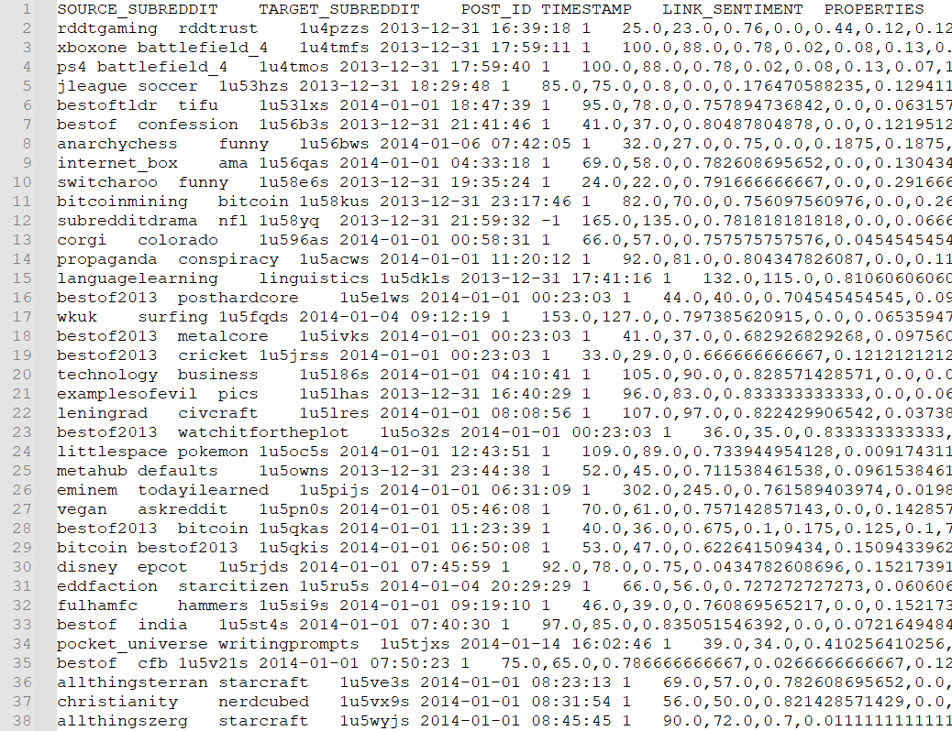
methodology
SNAP: Social Network: Reddit Hyperlink Network https://snap.stanford.edu/data/soc-RedditHyperlinks.html
The hyperlink network represents the directed connections between two subreddits. The network is extracted from publicly available Reddit data of 2.5 years from Jan 2014 to April 2017 containing 571928 crossposts.
The method is to calculate the fraction of nodes in the largest connected component and the mean shortest path length of the network along with the mean weight of these paths to decide whether it is possible and easy enough for a human to play the Wikirace game using crossposts as links between subreddits.

Slide 4
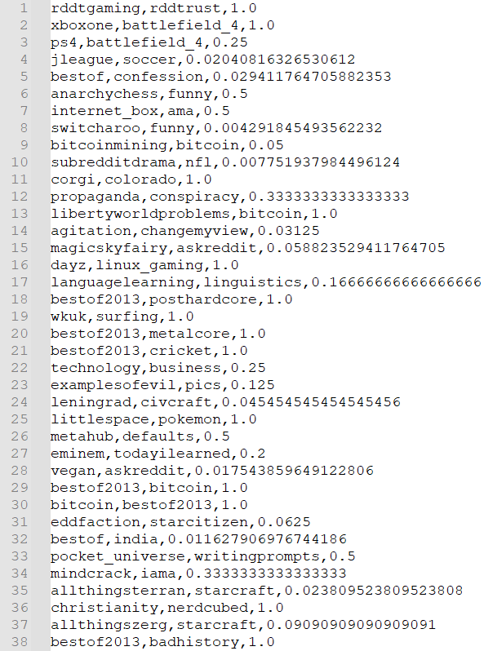
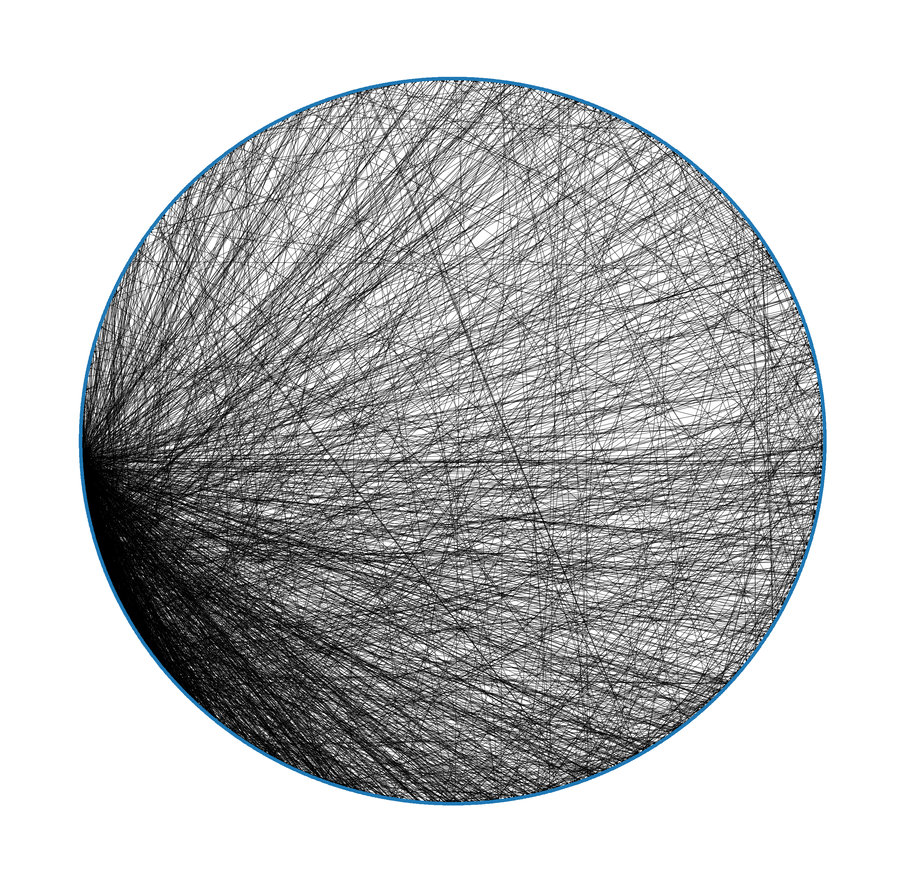
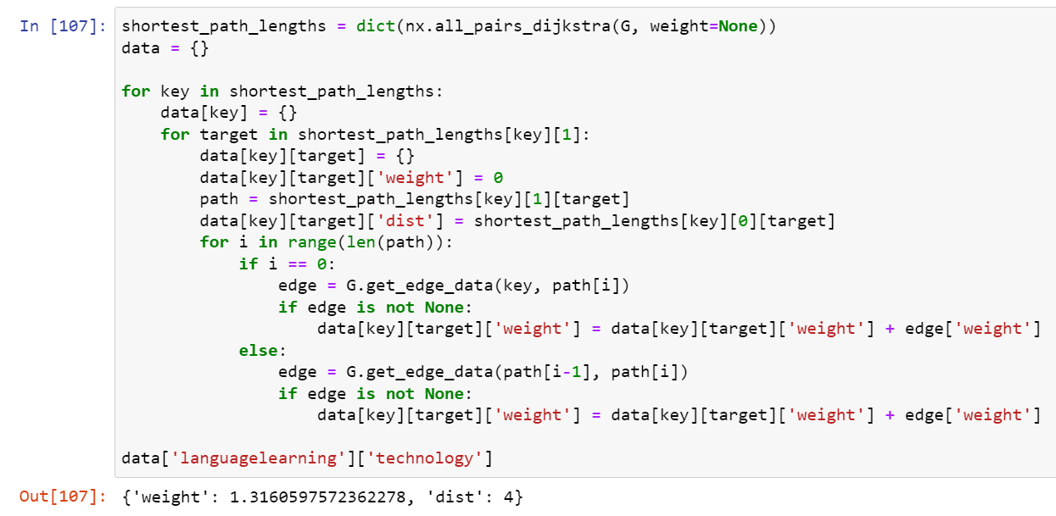
Experimental setup
The directed connections between two subreddits were represented as a weighted edge csv-list with weight calculated as inverse of the number of crossposts between the connected subreddits in order to help calculate the “difficulty” of traversion.
The resulting network consists of:
234792 edges
2135 nodes

Slide 5
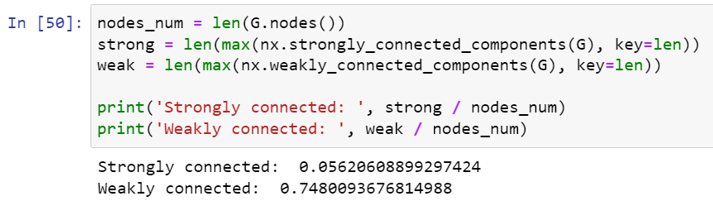
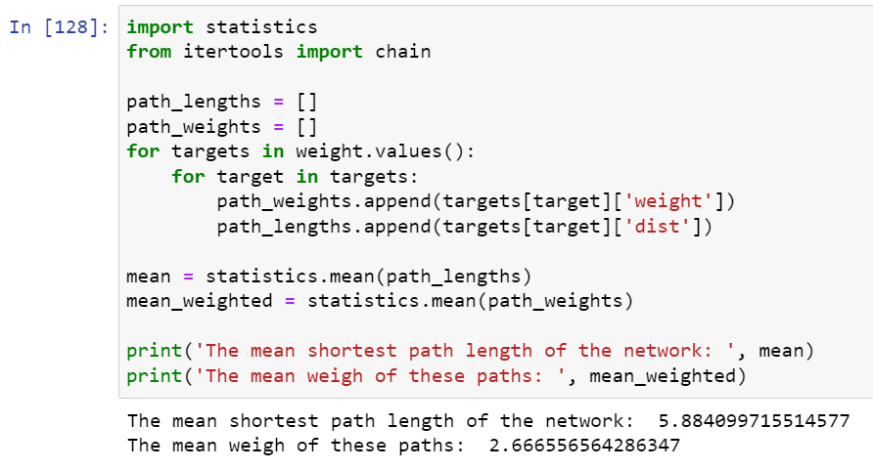
Calculation Results
The network is not connected, the fraction of vertices in the weakly connected component is 74.8% and the fraction of vertices in the strongly connected component is 5.6%.
The mean shortest path length of the network is 5.884 and the mean weight of these paths is 2.667.

Slide 6
discussion
The network under consideration is not connected, although the fraction of vertices in the weakly connected component is 74.8% which is high enough for the game to be possible, however the fraction of vertices in the strongly connected component is only 5.6% which does not guarantee that the game will have a large variety of starting and destination subreddits.
The mean shortest path length of the network is 5.884 and the mean weight of these paths is 2.667 which means that on average the best playthrough is going to be around 6 steps long but on this path each subreddit will have only around 2 crossposts leading to the next subreddit which, considering that the data spans over 2.5 years, may be very hard to find depending on the frequency of new posts on the subreddit.
In conclusion, the results above may be interpreted as such: it is possible to play the game although the difficulty of each run depends heavily on the frequency of new posts on the subreddits that lay on the path between the starting and destination subreddits. The result could be more certain if the data contained such information.

